Slide 1

6th Grade Accelerated Math
Unit 13, Lesson 2 Evaluating Algebraic Expressions Using Substitution Volume 2, pg. 270

Slide 2


Benchmark
MA.6.AR.1.3
Evaluate algebraic expressions using substitution and order of operations.
volume 2, pg. 270

Slide 3
Integrated Mathematical Thinking and Reasoning Standards
MA.K12.MTR.4.1 Engage in discussions that reflect on the mathematical thinking of self and others.
MA.K12.MTR.5.1 Use patterns and structure to help understand and connect mathematical concepts.
volume 2, pg. 270

Slide 4

Learning Target
I can evaluate algebraic expressions using substitution.
volume 2, pg. 270

Slide 5

Warm-Up
volume 2, pg. 270

Slide 6
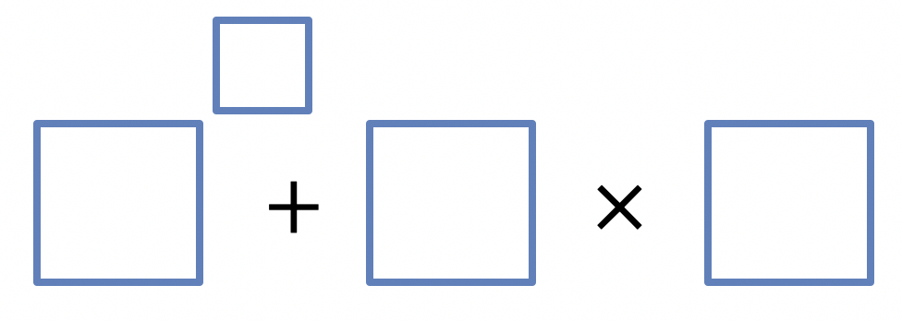
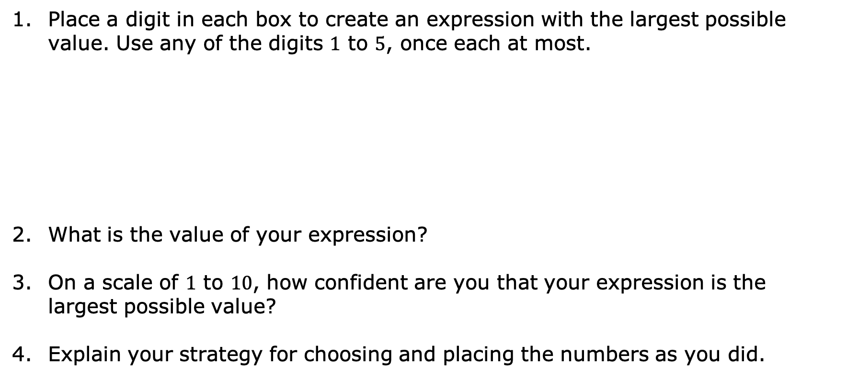
13.2.1 Warm-Up: Order Explorer
Place a digit in each box to create an expression with the largest possible value. Use any of the digits $1$ to $5$, once each at most.
What is the value of your expression?
On a scale of $1$ to $10$, how confident are you that your expression is the largest possible value?
Explain your strategy for choosing and placing the numbers as you did.
volume 2, pg. 270

Slide 7

Collaboration
volume 2, pg. 271

Slide 8

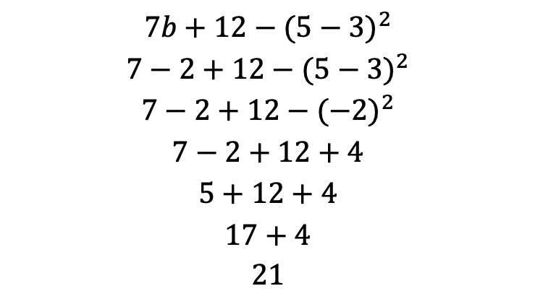
13.2.2 Collaboration: Evaluating Algebraic Expressions by Substituting Integers
Brae evaluated the expression $7b+12−{(5−3)}^{2}$ for $b=−2$. Her work is shown.
Evaluate her work and determine where she made mistakes.
$$7b+12−{(5−3)}^{2}$$
$$7−2+12−{(5−3)}^{2}$$
$$7−2+12−{(−2)}^{2}$$
$$7−2+12+4$$
$$5+12+4$$
$$17+4$$
$21$
volume 2, pg. 271

Slide 9
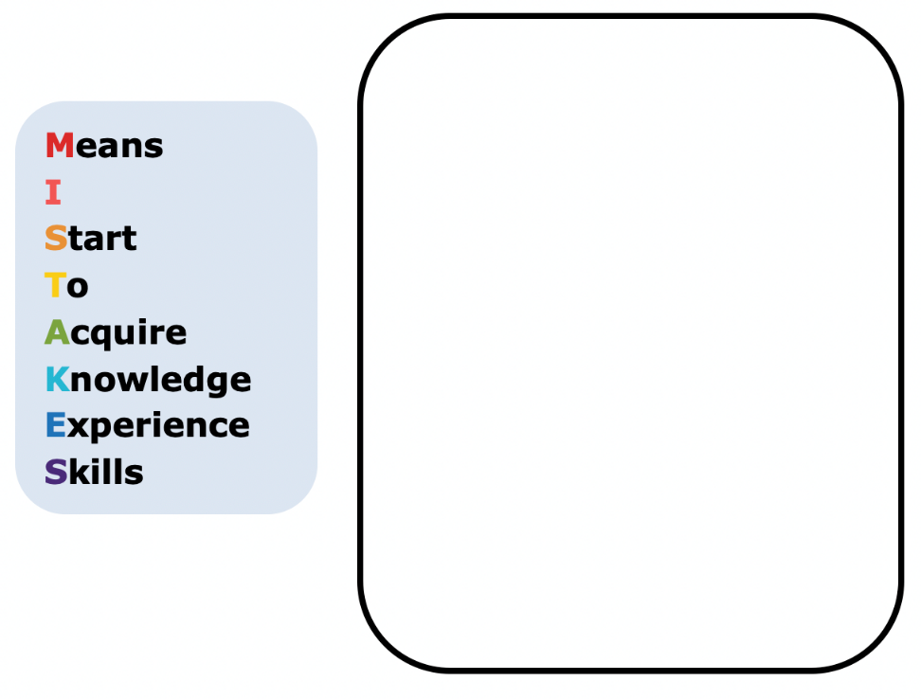
Help Brae understand and learn from her mistakes. Write a brief note to Brae explaining what her mistakes were and how she could learn from the mistakes.
volume 2, pg. 271

Slide 10

Read the note your partner wrote and offer suggestions on ways to improve their note.
Using the word bank below, complete the three reminders that could help Brae.
When substituting values into algebraic expressions, it is helpful to put the substituted value(s) in ____________.
When evaluating expressions with exponents, if the negative is ____________ the parentheses, the negative indicates subtraction, or the opposite of the value found by raising the value inside to a power.
If the negative is ________ the parentheses, it indicates that the number is a negative number being raised to a power.
volume 2, pg. 271

Slide 11
Verify your answers with your partner and, if necessary, resolve any differences.
volume 2, pg. 271

Slide 12
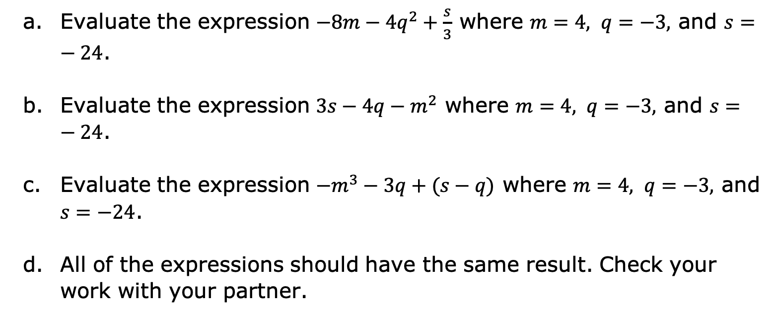
Complete the following problems.
Evaluate the expression $−8m−4q^{2}+\frac{s}{3}$ where $m=4, q=−3,$ and $s=−24$.
Evaluate the expression $3s−4q−m^{2}$ where $m=4, q=−3,$ and $s=−24$.
Evaluate the expression $−m^{3}−3q+(s−q)$ where $m=4, q=−3,$ and $s=−24$.
All of the expressions should have the same result. Check your work with your partner.
volume 2, pg. 272

Slide 13

Your Turn
volume 2, pg. 272

Slide 14
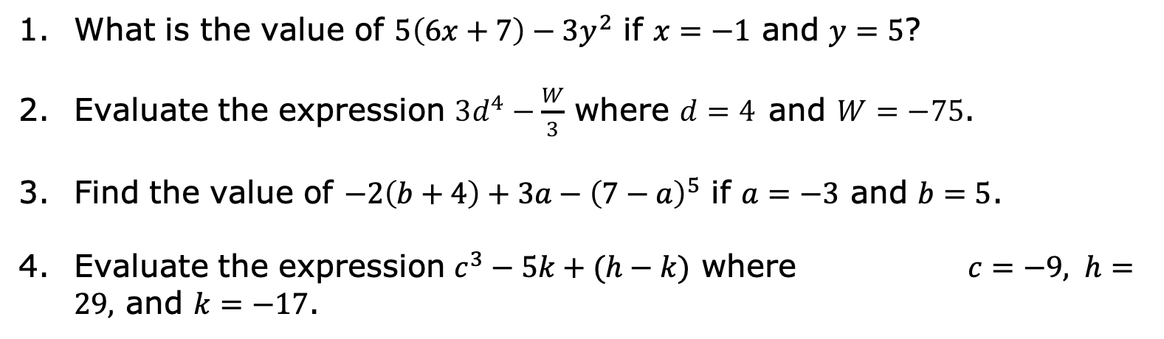
13.2.3 Your Turn!
What is the value of $5\left(6x+7\right)−3y^{2}$ if $x=−1$ and $y=5$?
Evaluate the expression $3d^{4}−\frac{W}{3}$ where $d=4$and $W=−75$.
Find the value of $−2\left(b+4\right)+3a−{\left(7−a\right)}^{5}$ if $a=−3$ and $b=5$.
Evaluate the expression $c^{3}−5k+(h−k)$ where $c=−9, h=29,$ and $k=−17$.
volume 2, pg. 272

Slide 15
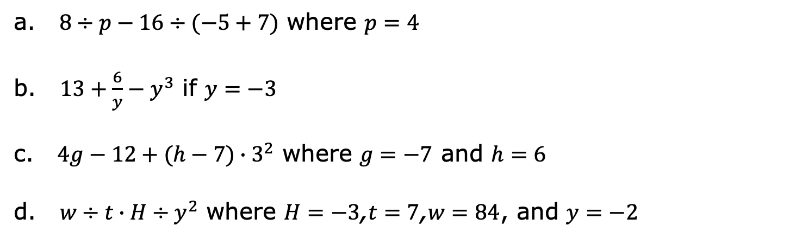
Evaluate each expression.
a. $8÷p−16÷(−5+7)$ where $p=4$
b. $13+\frac{6}{y}−y^{3}$ if $y=−3$
c. $4g−12+(h−7)∙3^{2}$ where $g=−7$ and $h=6$
d. $w÷t∙H÷y^{2}$ where $H=−3$,$t=7$,$w=84$, and $y=−2$
volume 2, pg. 273

Slide 16

Wrap-Up
volume 2, pg. 273

Slide 17
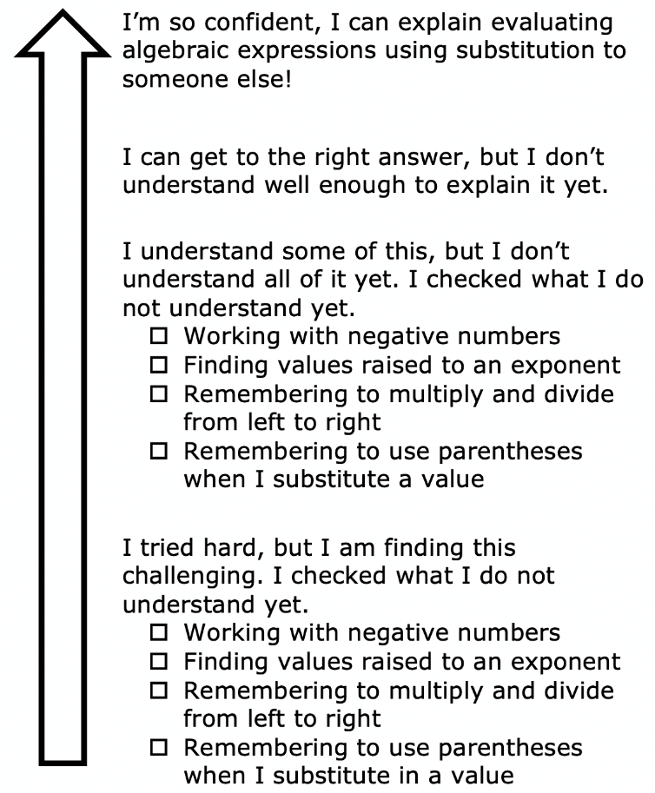
13.2.4 Wrap-Up: Reflection
Color in the arrow up to the statement that best describes your current understanding.
volume 2, pg. 273

